Slide 1



Memory Systems Fundamentals, Recent Research, Challenges, Opportunities Lecture 8: Asymmetric Multi-Core
Prof. Onur Mutlu
omutlu@gmail.com
https://people.inf.ethz.ch/omutlu
11 October 2018
Technion Fast Course 2018

Slide 2
Some Readings
Suleman et al., “Accelerating Critical Section Execution with Asymmetric Multi-Core Architectures,” ASPLOS 2009.
Joao et al., “Bottleneck Identification and Scheduling in Multithreaded Applications,” ASPLOS 2012.
Joao et al., “Bottleneck Identification and Scheduling for Multithreaded Applications,” ASPLOS 2012.
Joao et al., “Utility-Based Acceleration of Multithreaded Applications on Asymmetric CMPs,” ISCA 2013.
Grochowski et al., “Best of Both Latency and Throughput,” ICCD 2004.

Slide 3
Heterogeneity (Asymmetry)

Slide 4
Heterogeneity (Asymmetry) → Specialization
Heterogeneity and asymmetry have the same meaning
Contrast with homogeneity and symmetry
Heterogeneity is a very general system design concept (and life concept, as well)
Idea: Instead of having multiple instances of a “resource” to be the same (i.e., homogeneous or symmetric), design some instances to be different (i.e., heterogeneous or asymmetric)
Different instances can be optimized to be more efficient in executing different types of workloads or satisfying different requirements/goals
Heterogeneity enables specialization/customization

Slide 5
Why Asymmetry in Design? (I)
Different workloads executing in a system can have different behavior
Different applications can have different behavior
Different execution phases of an application can have different behavior
The same application executing at different times can have different behavior (due to input set changes and dynamic events)
E.g., locality, predictability of branches, instruction-level parallelism, data dependencies, serial fraction in a parallel program, bottlenecks in parallel portion of a program, interference characteristics, …
Systems are designed to satisfy different metrics at the same time
There is almost never a single goal in design, depending on design point
E.g., Performance, energy efficiency, fairness, predictability, reliability, availability, cost, memory capacity, latency, bandwidth, …

Slide 6
Why Asymmetry in Design? (II)
Problem: Symmetric design is one-size-fits-all
It tries to fit a single-size design to all workloads and metrics
It is very difficult to come up with a single design
that satisfies all workloads even for a single metric
that satisfies all design metrics at the same time
This holds true for different system components, or resources
Cores, caches, memory, controllers, interconnect, disks, servers, …
Algorithms, policies, …

Slide 7
Asymmetry Enables Customization
Symmetric: One size fits all
Energy and performance suboptimal for different “workload” behaviors
Asymmetric: Enables customization and adaptation
Processing requirements vary across workloads (applications and phases)
Execute code on best-fit resources (minimal energy, adequate perf.)
C
C
C
C
C1
C2
C
C
C
C
C3
C
C
C
C
C4
C4
C4
C4
C
C
C
C
C5
C5
C5
C5
Symmetric
Asymmetric

Slide 8
We Have Already Seen Examples (Before)
CRAY-1 design: scalar + vector pipelines
Modern processors: scalar instructions + SIMD extensions
Decoupled Access Execute: access + execute processors
Thread Cluster Memory Scheduling: different memory scheduling policies for different thread clusters
RAIDR: Heterogeneous refresh rates in DRAM
Heterogeneous-Latency DRAM (Tiered Latency DRAM)
Hybrid memory systems
DRAM + Phase Change Memory
Fast, Costly DRAM + Slow, Cheap DRAM
Reliable, Costly DRAM + Unreliable, Cheap DRAM
Heterogeneous cache replacement policies

Slide 9
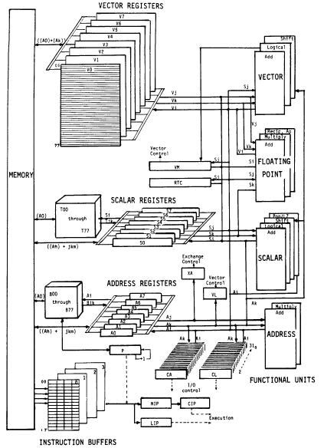
An Example Asymmetric Design: CRAY-1
CRAY-1
Russell, “The CRAY-1 computer system,” CACM 1978.
Scalar and vector modes
8 64-element vector registers
64 bits per element
16 memory banks
8 64-bit scalar registers
8 24-bit address registers

Slide 10
Remember: Hybrid Memory Systems
CPU
Meza+, “Enabling Efficient and Scalable Hybrid Memories,” IEEE Comp. Arch. Letters, 2012.
Yoon, Meza et al., “Row Buffer Locality Aware Caching Policies for Hybrid Memories,” ICCD 2012 Best Paper Award.
DRAMCtrl
PCM Ctrl
DRAM
Phase Change Memory (or Tech. X)
Fast, durable
Small,
leaky, volatile,
high-cost
Large, non-volatile, low-cost
Slow, wears out, high active energy
Hardware/software manage data allocation and movement
to achieve the best of multiple technologies

Slide 11
Remember: Throughput vs. Fairness
Throughput biased approach
Fairness biased approach
Prioritize less memory-intensive threads
Take turns accessing memory
Good for throughput
Does not starve
thread A
less memory intensive
thread B
higher
priority
thread C
thread A
thread B
thread C
not prioritized ➔
reduced throughput
starvation ➔ unfairness
Single policy for all threads is insufficient
Kim et al., “Thread Cluster Memory Scheduling,” MICRO 2010.
Notes:
So why do previous algorithms fail?
On the one hand there is the throughput biased approach that prioritizes less memory-intensive threads.
Servicing memory requests from such threads allow them to make progress in the processor, increasing throughput.
However, the most memory-intensive thread, thread C, remains persistently deprioritized and and becomes prone to starvation causing large slowdowns and, ultimately, unfairness.
On the other hand there is the fairness biased approach where threads take turns accessing the memory.
In this case, the most memory-intensive thread does not starve.
However, the least memory-intensive thread, thread A, is not prioritized, leading to reduced throughput.
As you can see, a single policy applied to all threads is insufficient since different threads have different memory access needs.

Slide 12

Remember: Achieving the Best of Both Worlds
higher
priority
For Throughput
Prioritize memory-non-intensive threads
thread
thread
thread
For Fairness
thread
Unfairness caused by memory-intensive being prioritized over each other
Shuffle thread ranking
Memory-intensive threads have different vulnerability to interference
Shuffle asymmetrically
thread
thread
thread
thread
thread
thread
thread
thread
Kim et al., “Thread Cluster Memory Scheduling,” MICRO 2010.
Notes:
So how do we achieve the best of both worlds? Our algorithm is based on the following insights:
First, we would like to prioritize the memory-non-intensive threads to increase system throughput.
Doing so does not degrade unfairness, since memory-non-intensive threads are inherently “light” and rarely cause interference for the memory-intensive threads.
For fairness, we discovered that unfairness is usually caused when one memory-intensive thread is prioritized over another.
As we’ve seen, the most deprioritized thread can starve.
To address this problem, we would like to shuffle their priority so that no single thread is persistently prioritized over another thread.
However, memory-intensive threads are not created equal.
They have different vulnerability to memory interference.
To address their differences, shuffling should be performed in an asymmetric manner.

Slide 13
Thread Cluster Memory Scheduling [Kim+ MICRO’10]
Group threads into two clusters
Prioritize non-intensive cluster
Different policies for each cluster
higher
priority
Memory-non-intensive
Non-intensive
cluster
thread
Throughput
thread
thread
thread
thread
thread
Prioritized
higher
priority
thread
thread
thread
thread
Threads in the system
Memory-intensive
Intensive cluster
Fairness
Kim et al., “Thread Cluster Memory Scheduling,” MICRO 2010.
Notes:
Our algorithm, Thread Cluster Memory Scheduling, first groups threads into two clusters.
Among the threads executing in the system, some are memory-non-intensive whereas some are memory-intensive.
We isolate the memory-non-intensive threads into the non-intensive cluster and the memory-intensive threads into the intensive cluster.
This is so that we can apply different policies for different threads.
Subsequently, we prioritize the non-intensive cluster over the intensive cluster since the non-intensive threads have greater potential for making progress IN THEIR CORES [ONUR].
Finally, we apply different policies within each cluster, one optimized for throughput and the other for fairness.

Slide 14
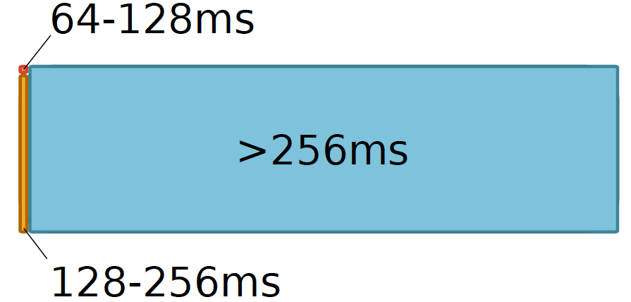
Remember: Heterogeneous Retention Times in DRAM
Liu et al., “RAIDR: Retention-Aware Intelligent DRAM Refresh,” ISCA 2012.

Slide 15
Trade-Off: Area (Die Size) vs. Latency
Long Bitline
Short Bitline
Faster
Smaller
Trade-Off: Area vs. Latency
Lee+, “Tiered-Latency DRAM: A Low Latency and Low Cost DRAM Architecture,” HPCA 2013.
Notes:
A naïve way to reduce the DRAM latency is to have short bitlines that have lower latency.
Unfortunately, short bitlines significantly increase the DRAM area.
Therefore, the bitline length exposes an important trade-off between area and latency.

Slide 16
Approximating the Best of Both Worlds
Long Bitline
Long Bitline
Our Proposal
Short Bitline
Short Bitline
Small Area
Large Area
Small Area
High Latency
Low Latency
Low Latency
Need Isolation
Add Isolation Transistors
Short Bitline ➔ Fast
Lee+, “Tiered-Latency DRAM: A Low Latency and Low Cost DRAM Architecture,” HPCA 2013.
Notes:
To sum up, both long and short bitline do not achieve small area and low latency.
Long bitline has small area but has high latency while short bitline has low latency but has large area.
To achieve the best of both worlds, we first start from long bitline, which has small area.
After that, to achieve the low latency of short bitline, we divide the long bitline into two smaller segments.
The bitline length of the segment nearby the sense-amplifier is same as the length of short bitline.
Therefore, the latency of the segment is as low as the latency of the short bitline.
To isolate this fast segment from the other segment, we add isolation transistors that selectively connect the two segments.

Slide 17
Approximating the Best of Both Worlds
Long Bitline
Tiered-Latency DRAM
Our Proposal
Short Bitline
Long Bitline
Short Bitline
Small Area
Small Area
Large Area
High Latency
Low Latency
Low Latency
Small area using long bitline
Low Latency
Lee+, “Tiered-Latency DRAM: A Low Latency and Low Cost DRAM Architecture,” HPCA 2013.
Notes:
This way, our proposed approach achieves small area and low latency.
We call this new DRAM architecture as Tiered-Latency DRAM

Slide 18
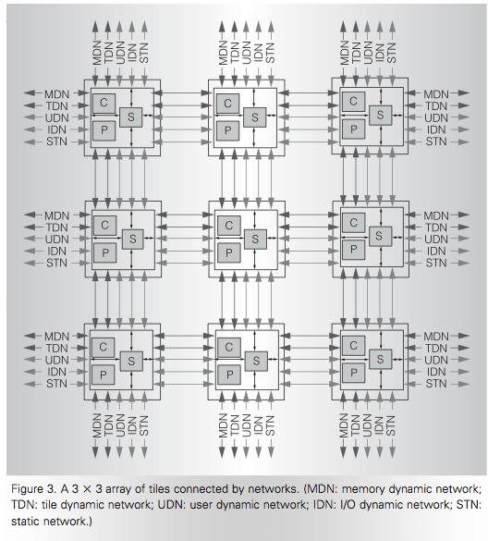
Heterogeneous Interconnects (in Tilera)
2D Mesh
Five networks
Four packet switched
Dimension order routing, wormhole flow control
TDN: Cache request packets
MDN: Response packets
IDN: I/O packets
UDN: Core to core messaging
One circuit switched
STN: Low-latency, high-bandwidth static network
Streaming data
Wentzlaff et al., “On-Chip Interconnection Architecture of the Tile Processor,” IEEE Micro 2007.

Slide 19
Aside: Examples from Life
Heterogeneity is abundant in life
both in nature and human-made components
Humans are heterogeneous
Cells are heterogeneous → specialized for different tasks
Organs are heterogeneous
Cars are heterogeneous
Buildings are heterogeneous
Rooms are heterogeneous
…

Slide 20
General-Purpose vs. Special-Purpose
Asymmetry is a way of enabling specialization
It bridges the gap between purely general purpose and purely special purpose
Purely general purpose: Single design for every workload or metric
Purely special purpose: Single design per workload or metric
Asymmetric: Multiple sub-designs optimized for sets of workloads/metrics and glued together
The goal of a good asymmetric design is to get the best of both general purpose and special purpose

Slide 21
Asymmetry Advantages and Disadvantages
Advantages over Symmetric Design
+ Can enable optimization of multiple metrics
+ Can enable better adaptation to workload behavior
+ Can provide special-purpose benefits with general-purpose usability/flexibility
Disadvantages over Symmetric Design
- Higher overhead and more complexity in design, verification
- Higher overhead in management: scheduling onto asymmetric components
- Overhead in switching between multiple components can lead to degradation

Slide 22
Yet Another Example
Modern processors integrate general purpose cores and GPUs
CPU-GPU systems
Heterogeneity in execution models

Slide 23
Three Key Problems in Future Systems
Memory system
Applications are increasingly data intensive
Data storage and movement limits performance & efficiency
Efficiency (performance and energy) → scalability
Enables scalable systems → new applications
Enables better user experience → new usage models
Predictability and robustness
Resource sharing and unreliable hardware causes QoS issues
Predictable performance and QoS are first class constraints
Asymmetric Designs
Can Help Solve These Problems

Slide 24
Commercial Asymmetric Design Examples
Integrated CPU-GPU systems (e.g., Intel SandyBridge)
CPU + Hardware Accelerators (e.g., your cell phone)
ARM big.LITTLE processor
IBM Cell processor

Slide 25
Increasing Asymmetry in Modern Systems
CPU
CPU
CPU
CPU
GPU
HWA
HWA
Shared Cache
DRAM and Hybrid Memory Controllers
DRAM and Hybrid Memories
Heterogeneous agents: CPUs, GPUs, and HWAs
Heterogeneous memories: Fast vs. Slow DRAM
Heterogeneous interconnects: Control, Data, Synchronization

Slide 26
Multi-Core Design: An Asymmetric Perspective

Slide 27
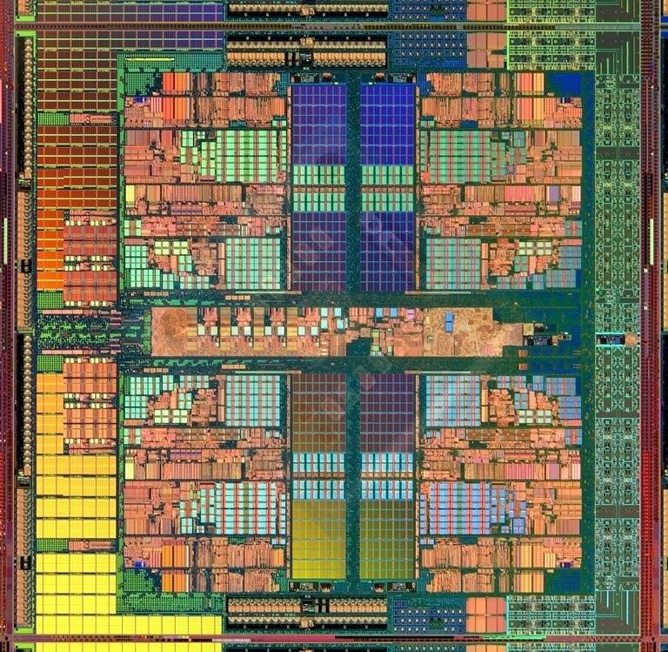
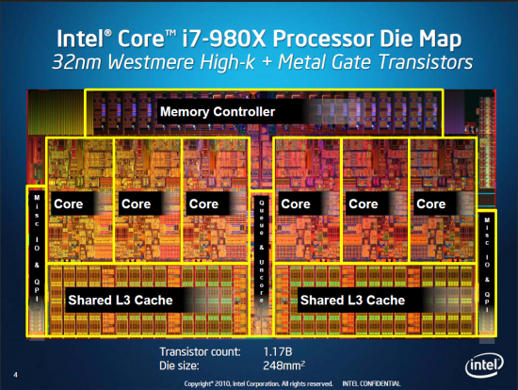
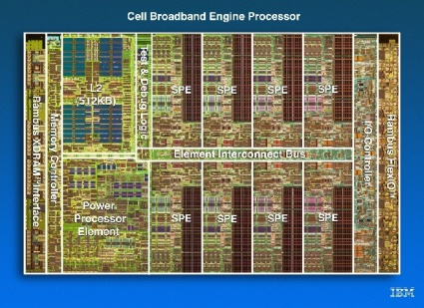
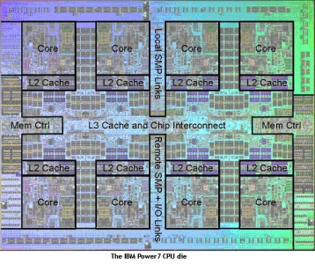
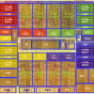
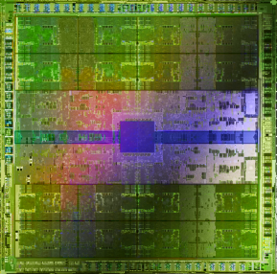
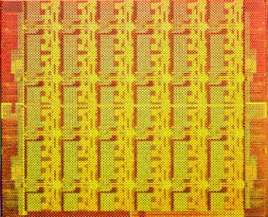
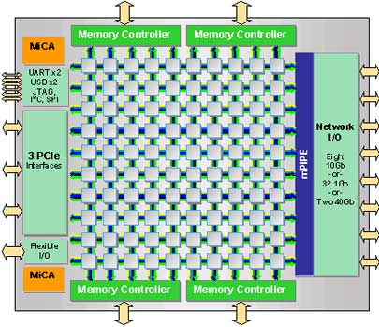
Many Cores on Chip
Simpler and lower power than a single large core
Large scale parallelism on chip
Intel Core i7 8 cores
IBM Cell BE 8+1 cores
IBM POWER7
8 cores
AMD Barcelona
4 cores
Nvidia Fermi
448 “cores”
Intel SCC
48 cores, networked
Tilera TILE Gx
100 cores, networked
Sun Niagara II
8 cores

Slide 28
With Many Cores on Chip
What we want:
N times the performance with N times the cores when we parallelize an application on N cores
What we get:
Amdahl’s Law (serial bottleneck)
Bottlenecks in the parallel portion

Slide 29
Caveats of Parallelism
Amdahl’s Law
f: Parallelizable fraction of a program
N: Number of processors
Amdahl, “Validity of the single processor approach to achieving large scale computing capabilities,” AFIPS 1967.
Maximum speedup limited by serial portion: Serial bottleneck
Parallel portion is usually not perfectly parallel
Synchronization overhead (e.g., updates to shared data)
Load imbalance overhead (imperfect parallelization)
Resource sharing overhead (contention among N processors)
1
Speedup =
1 - f
+
f
N

Slide 30
The Problem: Serialized Code Sections
Many parallel programs cannot be parallelized completely
Causes of serialized code sections
Sequential portions (Amdahl’s “serial part”)
Critical sections
Barriers
Limiter stages in pipelined programs
Serialized code sections
Reduce performance
Limit scalability
Waste energy

Slide 31
Example from MySQL
Asymmetric
Critical Section
Access Open Tables Cache
Open database tables
Speedup
Today
Perform the operations
….
Parallel
Chip Area (cores)
Notes:
I show an example from the MySQL database. Each database thread first>>>
opens the database tables it requires, and >>>
then processes the transaction >>>
While independent transactions can proceed in parallel, opening the tables requires accessing a shared data structure called the Open Table Caches. The open tables cache is a 2-dimensional a linked data structure accesses to which are difficult to parallelize. >>>
Thus the accesses are encapsulated in a critical section.>>>

Slide 32
Demands in Different Code Sections
What we want:
In a serialized code section → one powerful “large” core
In a parallel code section → many wimpy “small” cores
These two conflict with each other:
If you have a single powerful core, you cannot have many cores
A small core is much more energy and area efficient than a large core

Slide 33
“Large” vs. “Small” Cores
Large Core
Small Core
Out-of-order
Wide fetch e.g. 4-wide
Deeper pipeline
Aggressive branch predictor (e.g. hybrid)
Multiple functional units
Trace cache
Memory dependence speculation
In-order
Narrow Fetch e.g. 2-wide
Shallow pipeline
Simple branch predictor (e.g. Gshare)
Few functional units
Large Cores are power inefficient: e.g., 2x performance for 4x area (power)

Slide 34
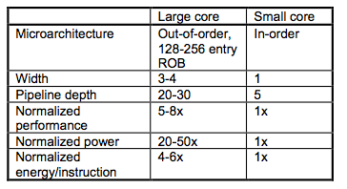
Large vs. Small Cores
Grochowski et al., “Best of both Latency and Throughput,” ICCD 2004.

Slide 35
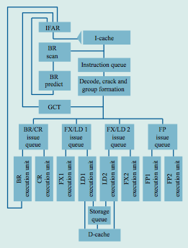
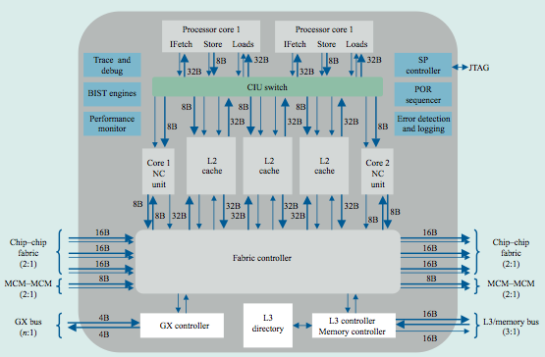
Meet Large: IBM POWER4
Tendler et al., “POWER4 system microarchitecture,” IBM J R&D, 2002.
A symmetric multi-core chip…
Two powerful cores

Slide 36
IBM POWER4
2 cores, out-of-order execution
100-entry instruction window in each core
8-wide instruction fetch, issue, execute
Large, local+global hybrid branch predictor
1.5MB, 8-way L2 cache
Aggressive stream based prefetching

Slide 37
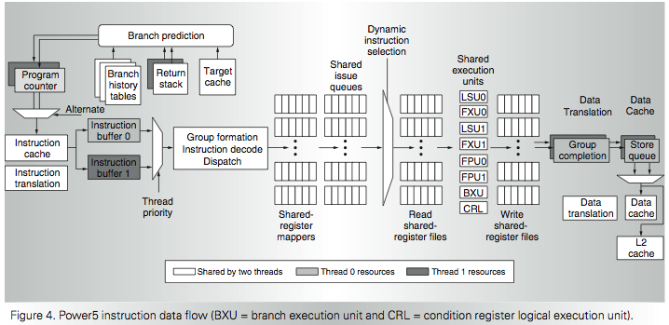
IBM POWER5
Kalla et al., “IBM Power5 Chip: A Dual-Core Multithreaded Processor,” IEEE Micro 2004.

Slide 38
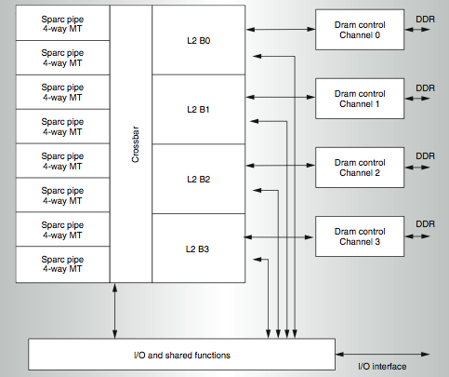
Meet Small: Sun Niagara (UltraSPARC T1)
Kongetira et al., “Niagara: A 32-Way Multithreaded SPARC Processor,” IEEE Micro 2005.

Slide 39
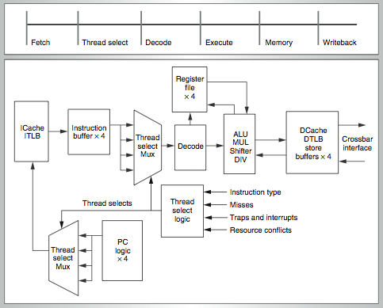
Niagara Core
4-way fine-grain multithreaded, 6-stage, dual-issue in-order
Round robin thread selection (unless cache miss)
Shared FP unit among cores

Slide 40
Remember the Demands
What we want:
In a serialized code section → one powerful “large” core
In a parallel code section → many wimpy “small” cores
These two conflict with each other:
If you have a single powerful core, you cannot have many cores
A small core is much more energy and area efficient than a large core
Can we get the best of both worlds?

Slide 41
Performance vs. Parallelism
Assumptions:
1. Small cores takes an area budget of 1 and has performance of 1
2. Large core takes an area budget of 4 and has performance of 2

Slide 42
Tile-Large Approach
Tile a few large cores
IBM Power 5, AMD Barcelona, Intel Core2Quad, Intel Nehalem
+ High performance on single thread, serial code sections (2 units)
- Low throughput on parallel program portions (8 units)
Large
core
Large core
Large core
Large core
“Tile-Large”

Slide 43
Tile-Small Approach
Tile many small cores
Sun Niagara, Intel Larrabee, Tilera TILE (tile ultra-small)
+ High throughput on the parallel part (16 units)
- Low performance on the serial part, single thread (1 unit)
Small core
Small core
Small core
Small core
Small core
Small core
Small core
Small core
Small core
Small core
Small core
Small core
Small core
Small core
Small core
Small core
“Tile-Small”

Slide 44
Can we get the best of both worlds?
Tile Large
+ High performance on single thread, serial code sections (2 units)
- Low throughput on parallel program portions (8 units)
Tile Small
+ High throughput on the parallel part (16 units)
- Low performance on the serial part, single thread (1 unit), reduced single-thread performance compared to existing single thread processors
Idea: Have both large and small on the same chip → Performance asymmetry

Slide 45
Asymmetric Multi-Core

Slide 46
Asymmetric Chip Multiprocessor (ACMP)
Provide one large core and many small cores
+ Accelerate serial part using the large core (2 units)
+ Execute parallel part on small cores and large core for high throughput (12+2 units)
Large
core
Large core
Small core
Small core
Small core
Small core
Large
core
Small core
Small core
Small core
Small core
Small core
Small core
Small core
Small core
Large core
Large core
Small core
Small core
Small core
Small core
Small core
Small core
Small core
Small core
Small core
Small core
Small core
Small core
Small core
Small core
Small core
Small core
“Tile-Large”
“Tile-Small”
ACMP

Slide 47
Accelerating Serial Bottlenecks
Single thread → Large core
Large
core
Small core
Small core
Small core
Small core
Small core
Small core
Small core
Small core
Small core
Small core
Small core
Small core
ACMP Approach

Slide 48
Performance vs. Parallelism
Assumptions:
1. Small cores takes an area budget of 1 and has performance of 1
2. Large core takes an area budget of 4 and has performance of 2

Slide 49
ACMP Performance vs. Parallelism
Area-budget = 16 small cores
Large
core
Large core
Small core
Small core
Small core
Small core
Large
core
Small core
Small core
Small core
Small core
Small core
Small core
Small core
Small core
Large core
Large core
Small core
Small core
Small core
Small core
Small core
Small core
Small core
Small core
Small core
Small core
Small core
Small core
Small core
Small core
Small core
Small core
“Tile-Large”
“Tile-Small”
ACMP
Large Cores | 4 | 0 | 1
Small Cores | 0 | 16 | 12
Serial Performance | 2 | 1 | 2
Parallel Throughput | 2 x 4 = 8 | 1 x 16 = 16 | 1x2 + 1x12 = 14
49

Slide 50
Amdahl’s Law Modified
Simplified Amdahl’s Law for an Asymmetric Multiprocessor
Assumptions:
Serial portion executed on the large core
Parallel portion executed on both small cores and large cores
f: Parallelizable fraction of a program
L: Number of large processors
S: Number of small processors
X: Speedup of a large processor over a small one
1
Speedup =
1 - f
+
f
X
S + X*L

Slide 51
Caveats of Parallelism, Revisited
Amdahl’s Law
f: Parallelizable fraction of a program
N: Number of processors
Amdahl, “Validity of the single processor approach to achieving large scale computing capabilities,” AFIPS 1967.
Maximum speedup limited by serial portion: Serial bottleneck
Parallel portion is usually not perfectly parallel
Synchronization overhead (e.g., updates to shared data)
Load imbalance overhead (imperfect parallelization)
Resource sharing overhead (contention among N processors)
1
Speedup =
1 - f
+
f
N

Slide 52
Accelerating Parallel Bottlenecks
Serialized or imbalanced execution in the parallel portion can also benefit from a large core
Examples:
Critical sections that are contended
Parallel stages that take longer than others to execute
Idea: Dynamically identify these code portions that cause serialization and execute them on a large core

Slide 53
Accelerated Critical Sections
M. Aater Suleman, Onur Mutlu, Moinuddin K. Qureshi, and Yale N. Patt, "Accelerating Critical Section Execution with Asymmetric Multi-Core Architectures" Proceedings of the 14th International Conference on Architectural Support for Programming Languages and Operating Systems (ASPLOS), 2009

Slide 54
Contention for Critical Sections
12 iterations, 33% instructions inside the critical section
Critical Section
Parallel
Idle
P = 4
P = 3
P = 2
33% in critical section
P = 1
0
1
2
3
4
5
6
7
8
9
10
11
12
Notes:
For simplicity lets assume that when run as a single thread, each database transaction spends 33% of its time inside the critical section and 75% of its time executing the parallel portion. >>>
I show execution of 16 transactions on a single core. The red represent the critical sections and the grey represent the non-critical section code.>>>
With 2 cores, overall execution time is halved >>>
With 4 cores, the execution time is again halved however note that the critical section is being run at all times. Thus, performance has become critical section limited ..>>>
Further increasing the cores to 8, does not reduce execution time. >>>
Thus critical sections reduce performance and limit scalability.

Slide 55
Contention for Critical Sections
12 iterations, 33% instructions inside the critical section
Critical Section
Parallel
Idle
P = 4
Accelerating critical sections increases performance and scalability
P = 3
Critical Section Accelerated by 2x
P = 2
P = 1
0
1
2
3
4
5
6
7
8
9
10
11
12
Notes:
However, I can accelerate the critical section. When we accelerate the critical section execution by 2x, the time inside the critical section reduces to half. I use blue to show the accelerated critical section. At one core, the overall execution time reduces. >>>
Similarly execution time also reduces at 2, 3, and 4 cores. >>>
Most notably, due to the shorter critical sections, performance no longer saturates at 4 cores. Instead, execution time continues to reduce until 4 cores.

Slide 56
Impact of Critical Sections on Scalability
Contention for critical sections leads to serial execution (serialization) of threads in the parallel program portion
Contention for critical sections increases with the number of threads and limits scalability
Asymmetric
Speedup
Today
MySQL (oltp-1)
Chip Area (cores)

Slide 57
A Case for Asymmetry
Execution time of sequential kernels, critical sections, and limiter stages must be short
It is difficult for the programmer to shorten these serialized sections
Insufficient domain-specific knowledge
Variation in hardware platforms
Limited resources
Performance-debugging tradeoff
Goal: A mechanism to shorten serial bottlenecks without requiring programmer effort
Idea: Accelerate serialized code sections by shipping them to powerful cores in an asymmetric multi-core (ACMP)

Slide 58
An Example: Accelerated Critical Sections
Idea: HW/SW ships critical sections to a large, powerful core in an asymmetric multi-core architecture
Benefit:
Reduces serialization due to contended locks
Reduces the performance impact of hard-to-parallelize sections
Programmer does not need to (heavily) optimize parallel code → fewer bugs, improved productivity
Suleman et al., “Accelerating Critical Section Execution with Asymmetric Multi-Core Architectures,” ASPLOS 2009, IEEE Micro Top Picks 2010.
Suleman et al., “Data Marshaling for Multi-Core Architectures,” ISCA 2010, IEEE Micro Top Picks 2011.
Notes:
SHOW a picture of ACMP and shipping…
Aater’s picture…

Slide 59
Conventional ACMP
EnterCS()
PriorityQ.insert(…)
LeaveCS()
P2 encounters a Critical Section
Sends a request for the lock
Acquires the lock
Executes Critical Section
Releases the lock
P1
Core executing critical section
P2
P3
P4
On-chip Interconnect
Notes:
Consider an ACMP with one large core and 3 small cores, ALL executing parallel threads. Initially P3, shown in red is executing the critical section.
When P2 encounters a critical section.
It sends a request for the lock to P3, which is executing the critical section currently.
P2 is able to acquire the lock after P3 releases the lock.
P2 then executes the critical sections and
releases the lock at the end.

Slide 60
Accelerated Critical Sections (ACS)
Accelerate Amdahl’s serial part and critical sections using the large core
Suleman et al., “Accelerating Critical Section Execution with Asymmetric Multi-Core Architectures,” ASPLOS 2009, IEEE Micro Top Picks 2010.
Large
core
Small core
Small core
Critical Section Request Buffer (CSRB)
Small core
Small core
Small core
Small core
Small core
Small core
Small core
Small core
Small core
Small core
ACMP

Slide 61
Accelerated Critical Sections
EnterCS()
PriorityQ.insert(…)
LeaveCS()
1. P2 encounters a critical section (CSCALL)
2. P2 sends CSCALL Request to CSRB
3. P1 executes Critical Section
4. P1 sends CSDONE signal
P1
Core executing critical section
P2
P3
P4
Critical Section Request Buffer (CSRB)
Onchip-Interconnect
Notes:
To accelerate critical sections, the large core is augmented with a critical section request buffer or CSRB. >>>
When a small core encounters a critical section, it ships to the large core. The large core completes the ciritcal section and notifies the requesting core.
For example, When P2 encounters a critical sections,>>>
its sends a request to the large core and becomes idle.>>>
The request is buffered at the CSRB and>>>
is serviced by the large core at the first opportunity.>>>
The large core sends a CSDONE signal when it has completed the critical section. At this point, P2 resumes execution.
61

Slide 62
Conventional ACMP
EnterCS()
PriorityQ.insert(…)
LeaveCS()
P2 encounters a Critical Section
Sends a request for the lock
Acquires the lock
Executes Critical Section
Releases the lock
P1
Core executing critical section
P2
P3
P4
On-chip Interconnect
Notes:
Consider an ACMP with one large core and 3 small cores, ALL executing parallel threads. Initially P3, shown in red is executing the critical section.
When P2 encounters a critical section.
It sends a request for the lock to P3, which is executing the critical section currently.
P2 is able to acquire the lock after P3 releases the lock.
P2 then executes the critical sections and
releases the lock at the end.

Slide 63
Accelerated Critical Sections (ACS)
Accelerate Amdahl’s serial part and critical sections using the large core
Suleman et al., “Accelerating Critical Section Execution with Asymmetric Multi-Core Architectures,” ASPLOS 2009, IEEE Micro Top Picks 2010.
Large
core
Small core
Small core
Critical Section Request Buffer (CSRB)
Small core
Small core
Small core
Small core
Small core
Small core
Small core
Small core
Small core
Small core
ACMP

Slide 64
Accelerated Critical Sections (ACS)
EnterCS()
PriorityQ.insert(…)
LeaveCS()
1. P2 encounters a critical section (CSCALL)
2. P2 sends CSCALL Request to CSRB
3. P1 executes Critical Section
4. P1 sends CSDONE signal
P1
Core executing critical section
P2
P3
P4
Critical Section Request Buffer (CSRB)
Onchip-Interconnect

Slide 65
ACS Architecture Overview
ISA extensions
CSCALL LOCK_ADDR, TARGET_PC
CSRET LOCK_ADDR
Compiler/Library inserts CSCALL/CSRET
On a CSCALL, the small core:
Sends a CSCALL request to the large core
Arguments: Lock address, Target PC, Stack Pointer, Core ID
Stalls and waits for CSDONE
Large Core
Critical Section Request Buffer (CSRB)
Executes the critical section and sends CSDONE to the requesting core
Notes:
ACS requires support from the ISA, compiler, and the microarchitecture. We require two new instructions, CSCALL and CSRET. CSCALL has two arguments: the address of the lock protecting the critical section and the starting address of the critical section. CSRET takes the address of the lock as its only argument.
The compiler or the library inserts CSCALL and CSRET at the beginning and end of the critical section respectively.
When a small core encounters a CSCALL instruction, it sends the CSCALL request together with its stack pointer and core ID to the large core. AND waits for the CSDONE signal.
The large core buffers the request in the CSRB and executes the critical sections. It sends a CSDONE signal to the small core on completion.

Slide 66
Accelerated Critical Sections (ACS)
Small Core
Small Core
Large Core
Suleman et al., “Accelerating Critical Section Execution with Asymmetric Multi-Core Architectures,” ASPLOS 2009.
A = compute()
A = compute()
LOCK X
result = CS(A)
UNLOCK X
print result
PUSH A
CSCALL X, Target PC
…
…
…
CSCALL Request
…
…
…
Send X, TPC, STACK_PTR, CORE_ID
Waiting in Critical Section Request Buffer (CSRB)
…
…
…
…
TPC:
Acquire X
POP A
result = CS(A)
PUSH result
Release X
CSRET X
CSDONE Response
POP result
print result

Slide 67
False Serialization
ACS can serialize independent critical sections
Selective Acceleration of Critical Sections (SEL)
Saturating counters to track false serialization
To large core
4
CSCALL (A)
3
A
2
Critical Section Request Buffer (CSRB)
4
CSCALL (A)
B
5
CSCALL (B)
From small cores
Notes:
While executing the critical sections on the large core accelerates their execution, ACS can serialize the execution of independent critical sections. Independent critical sections protect disjoint data and can execute concurrently in conventional systems. Since ACS sends all critical sections to the large core, their execution can get serialized. WE call this false serialization. To reduce the effect of false serialization,
we implement a mechanism to selectively disable the acceleration of critical sections which are experiencing false serialization. We call it SEL.
To implement SEL, we add a table of saturating counters to the CSRB which track false serialization. For simplicity, assume there is one counter for every independent critical section. A counter is incremented when the critical section experiences false serialization and decremented otherwise.
For example, consider a system with two critical sections A and B and an empty CSRB.
A CSCALL for critical section A arrives. Since there are no other entries, there is no false serialization, so
the counter corresponding to critical section A is decremented.
While the first call is still in progress, another CSCALL for A arrives. Again, there is NO false serialization since CSCALL for A would have waited for the first instance of critical section A even in the conventional system.
Thus counter for A is again decremented.
Now a CSCALL for B is enters the CSRB. Since B now has to wait for critical section A, which it should NOT. We say that B is experiencing false serialization and
increment its counter.
When a counter reaches its maximum value, acceleration for that critical section is disabled and conventional locking is used for its execution from there on.

Slide 68
ACS Performance Tradeoffs
Pluses
+ Faster critical section execution
+ Shared locks stay in one place: better lock locality
+ Shared data stays in large core’s (large) caches: better shared data locality, less ping-ponging
Minuses
- Large core dedicated for critical sections: reduced parallel throughput
- CSCALL and CSDONE control transfer overhead
- Thread-private data needs to be transferred to large core: worse private data locality

Slide 69
ACS Performance Tradeoffs
Fewer parallel threads vs. accelerated critical sections
Accelerating critical sections offsets loss in throughput
As the number of cores (threads) on chip increase:
Fractional loss in parallel performance decreases
Increased contention for critical sections makes acceleration more beneficial
Overhead of CSCALL/CSDONE vs. better lock locality
ACS avoids “ping-ponging” of locks among caches by keeping them at the large core
More cache misses for private data vs. fewer misses for shared data
Notes:
ACS dedicates the large core for execution of critical sections which could otherwise be used for executing additional threads. This reduces peak parallel throughput. However, we find that in critical section intensive workloads this is not a problem since the benefit obtained by accelerating of critical sections offsets the loss in peak parallel throughput.
Moreover, we observe that this problem will be further reduce as the number of cores on the chip increase for two reasons.
First, the fraction of throughput lost due to ACS decreases. For example, loosing 4 cores in a 64-core system will be a much smaller loss than loosing 4 cores in a 8-core system.
Second, contention for critical sections increases as the number of concurrent threads increase. When contention is high, accelerating the critical sections not only reduces the critical section execution time BUT also the waiting time for contending threads. Thereby making the acceleration even more beneficial.
ACS also incurs the overhead of sending CSCALL and CSDONE signals.
This overhead is similar to the conventional systems because in conventional systems lock acquire operations often generate a cache miss and the lock variable is brought from another core. In ACS, since all critical sections execute on one LARGE core, the lock variables stay resident in its cache which saves cache misses. Thus, overall, ACS has similar latency.
In ACS the input arguments to the critical section must be transferred from the cache of the small core to the cache of the large core. Let me explain this trade-off with an example.

Slide 70
Cache Misses for Private Data
PriorityHeap.insert(NewSubProblems)
Private Data: NewSubProblems
Shared Data: The priority heap
Puzzle Benchmark
Notes:
Consider this critical section from the puzzle benchmark. This critical sections protects a priority heap. The input argument is the node to be inserted on the heap.
The priority heap is the Shared data which is data protected by the critical sections and private data is the incoming node to be inserted.
During execution, multiple nodes of the heap are touched to find the right place to insert the incoming private data. In conventional systems, the shared data usually moves from cache-to-cache as different cores modify it inside critical sections. The private data is usually available locally. In ACS, since all critical sections execute on the large core, the shared data stays resident AT the large and does not move from cache to cache. However, private data has to be brought in from the small requesting core to execute the critical section.

Slide 71
ACS Performance Tradeoffs
Fewer parallel threads vs. accelerated critical sections
Accelerating critical sections offsets loss in throughput
As the number of cores (threads) on chip increase:
Fractional loss in parallel performance decreases
Increased contention for critical sections makes acceleration more beneficial
Overhead of CSCALL/CSDONE vs. better lock locality
ACS avoids “ping-ponging” of locks among caches by keeping them at the large core
More cache misses for private data vs. fewer misses for shared data
Cache misses reduce if shared data > private data
This problem can be solved
See Suleman et al., “Data Marshaling for Multi-Core Architectures,” ISCA 2010.

Slide 72
ACS Comparison Points
Small core
Small core
Small core
Small core
Large
core
Small core
Small core
Large
core
Small core
Small core
Small core
Small core
Small core
Small core
Small core
Small core
Small core
Small core
Small core
Small core
Small core
Small core
Small core
Small core
Small core
Small core
Small core
Small core
Small core
Small core
Small core
Small core
Small core
Small core
Small core
Small core
Small core
Small core
Small core
Small core
Small core
Small core
SCMP
ACMP
ACS
Conventional locking
Conventional locking
Large core executes Amdahl’s serial part
Large core executes Amdahl’s serial part and critical sections
Notes:
In our experiments we simulated three configurations.
First, A symmetric CMP or SCMP with all small cores. The numbers of cores is equal to the chip area and conventional locks are used for critical sections.
Second, an ACMP with one large core and remaining small cores. The large core takes the area of 4 small cores. The large core is used to execute Amdahl’s bottleneck. Critical Sections are executed using conventional locking.
Third, ACS, which is an ACMP with a CSRB and support for accelerating critical sections. In ACS, the Amdahl’s bottleneck as well as the critical sections execute on the large core.
The large core replceas four small cores. When chip area increases, we increase the number of small cores in all three confgiurations. At area 16, the SCMP has 16 small cores and the ACMP and ACS has 1 large core and 12 small cores. At area 32, the SCMP has 32 small cores and ACMP and ACS have 1 large core and 28 small cores.
We use the ACMP as our baseline.

Slide 73
Accelerated Critical Sections: Methodology
Workloads: 12 critical section intensive applications
Data mining kernels, sorting, database, web, networking
Multi-core x86 simulator
1 large and 28 small cores
Aggressive stream prefetcher employed at each core
Details:
Large core: 2GHz, out-of-order, 128-entry ROB, 4-wide, 12-stage
Small core: 2GHz, in-order, 2-wide, 5-stage
Private 32 KB L1, private 256KB L2, 8MB shared L3
On-chip interconnect: Bi-directional ring, 5-cycle hop latency

Slide 74
ACS Performance
Chip Area = 32 small cores SCMP = 32 small cores ACMP = 1 large and 28 small cores
Equal-area comparison Number of threads = Best threads
269 180 185
Coarse-grain locks
Fine-grain locks

Slide 75
Equal-Area Comparisons
------ SCMP
------ ACMP
------ ACS
Number of threads = No. of cores
(a) ep
(b) is
(c) pagemine
(d) puzzle
(e) qsort
(f) tsp
Speedup over a small core
(g) sqlite
(h) iplookup
(i) oltp-1
(i) oltp-2
(k) specjbb
(l) webcache
Chip Area (small cores)
Notes:
Now we will compare SCMP, ACMP, and ACS as the chip area increases. The X-axis is chip area and the Y-axis shows speedup over a SINGLE small core. The green line shows ACS, the red line shows the ACMP, and blue line shows the SCMP. Here we set the number of threads equal to the number of available cores.
As you can see, critical sections severely limit the scalability of some benchmarks. For example, performance of PageMine saturates at only 8 threads. Notice that the peak speedup of ACS is higher than both ACMP and SCMP and ACS does not saturate until 12 threads.
More importantly, In case of puzzle and oltp-1, while the ACMP and SCMP show poor scalability ACS significantly improves scalability as well as speedup.
In all, ACS improves scalability in 7 out of the 12 workloads.

Slide 76
ACS Summary
Critical sections reduce performance and limit scalability
Accelerate critical sections by executing them on a powerful core
ACS reduces average execution time by:
34% compared to an equal-area SCMP
23% compared to an equal-area ACMP
ACS improves scalability of 7 of the 12 workloads
Generalizing the idea: Accelerate all bottlenecks (“critical paths”) by executing them on a powerful core

Slide 77
More on Accelerated Critical Sections
M. Aater Suleman, Onur Mutlu, Moinuddin K. Qureshi, and Yale N. Patt, "Accelerating Critical Section Execution with Asymmetric Multi-Core Architectures" Proceedings of the 14th International Conference on Architectural Support for Programming Languages and Operating Systems (ASPLOS), pages 253-264, Washington, DC, March 2009. Slides (ppt)

Slide 78
Bottleneck Identification and Scheduling
Jose A. Joao, M. Aater Suleman, Onur Mutlu, and Yale N. Patt, "Bottleneck Identification and Scheduling in Multithreaded Applications" Proceedings of the 17th International Conference on Architectural Support for Programming Languages and Operating Systems (ASPLOS), London, UK, March 2012.

Slide 79
BIS Summary
Problem: Performance and scalability of multithreaded applications are limited by serializing bottlenecks
different types: critical sections, barriers, slow pipeline stages
importance (criticality) of a bottleneck can change over time
Our Goal: Dynamically identify the most important bottlenecks and accelerate them
How to identify the most critical bottlenecks
How to efficiently accelerate them
Solution: Bottleneck Identification and Scheduling (BIS)
Software: annotate bottlenecks (BottleneckCall, BottleneckReturn) and implement waiting for bottlenecks with a special instruction (BottleneckWait)
Hardware: identify bottlenecks that cause the most thread waiting and accelerate those bottlenecks on large cores of an asymmetric multi-core system
Improves multithreaded application performance and scalability, outperforms previous work, and performance improves with more cores

Slide 80
Bottlenecks in Multithreaded Applications
Definition: any code segment for which threads contend (i.e. wait)
Examples:
Amdahl’s serial portions
Only one thread exists → on the critical path
Critical sections
Ensure mutual exclusion → likely to be on the critical path if contended
Barriers
Ensure all threads reach a point before continuing → the latest thread arriving is on the critical path
Pipeline stages
Different stages of a loop iteration may execute on different threads, slowest stage makes other stages wait → on the critical path

Slide 81
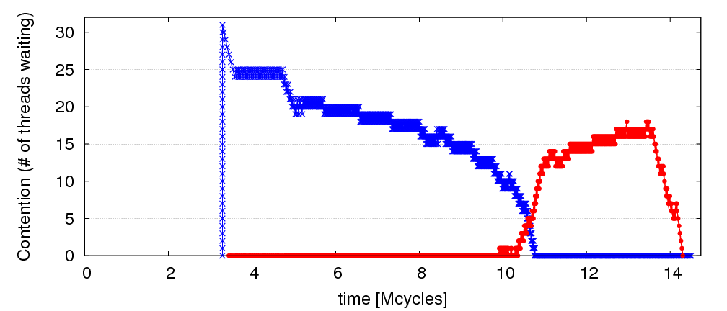
Observation: Limiting Bottlenecks Change Over Time
A=full linked list; B=empty linked list
repeat
Lock A
Traverse list A
Remove X from A
Unlock A
Compute on X
Lock B
Traverse list B
Insert X into B
Unlock B
until A is empty
32 threads
Lock B is limiter
Lock A is limiter

Slide 82
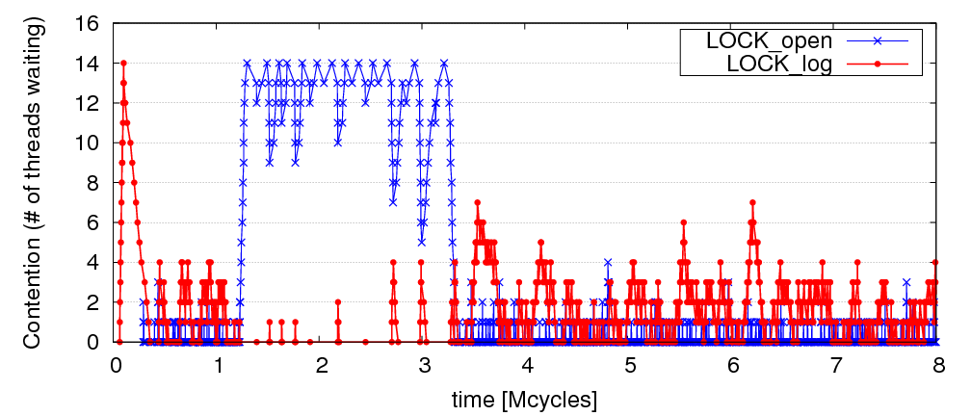
Limiting Bottlenecks Do Change on Real Applications
MySQL running Sysbench queries, 16 threads

Slide 83
Previous Work on Bottleneck Acceleration
Asymmetric CMP (ACMP) proposals [Annavaram+, ISCA’05] [Morad+, Comp. Arch. Letters’06] [Suleman+, Tech. Report’07]
Accelerate only the Amdahl’s bottleneck
Accelerated Critical Sections (ACS) [Suleman+, ASPLOS’09]
Accelerate only critical sections
Does not take into account importance of critical sections
Feedback-Directed Pipelining (FDP) [Suleman+, PACT’10 and PhD thesis’11]
Accelerate only stages with lowest throughput
Slow to adapt to phase changes (software based library)
No previous work can accelerate all three types of bottlenecks or quickly adapts to fine-grain changes in the importance of bottlenecks
Our goal: general mechanism to identify performance-limiting bottlenecks of any type and accelerate them on an ACMP

Slide 84
Bottleneck Identification and Scheduling (BIS)
Key insight:
Thread waiting reduces parallelism and is likely to reduce performance
Code causing the most thread waiting → likely critical path
Key idea:
Dynamically identify bottlenecks that cause the most thread waiting
Accelerate them (using powerful cores in an ACMP)

Slide 85
Bottleneck Identification and Scheduling (BIS)
Compiler/Library/Programmer
Hardware
Annotate bottleneck code
Implement waiting
for bottlenecks
Measure thread waiting cycles (TWC) for each bottleneck
Accelerate bottleneck(s) with the highest TWC
Binary containing BIS instructions

Slide 86
Critical Sections: Code Modifications
…
…
…
BottleneckCall bid, targetPC
…
targetPC: while cannot acquire lock
Wait loop for watch_addr
acquire lock
…
release lock
BottleneckReturn bid
while cannot acquire lock
Wait loop for watch_addr
acquire lock
…
release lock
BottleneckWait bid, watch_addr
Used to enable acceleration
Used to keep track of waiting cycles

Slide 87
Barriers: Code Modifications
…
BottleneckCall bid, targetPC
enter barrier
while not all threads in barrier
BottleneckWait bid, watch_addr
exit barrier
…
targetPC: code running for the barrier
…
BottleneckReturn bid

Slide 88
Pipeline Stages: Code Modifications
BottleneckCall bid, targetPC
…
targetPC: while not done
while empty queue
BottleneckWait prev_bid
dequeue work
do the work …
while full queue
BottleneckWait next_bid
enqueue next work
BottleneckReturn bid

Slide 89
Bottleneck Identification and Scheduling (BIS)
Compiler/Library/Programmer
Hardware
Annotate bottleneck code
Implement waiting
for bottlenecks
Measure thread waiting cycles (TWC) for each bottleneck
Accelerate bottleneck(s) with the highest TWC
Binary containing BIS instructions

Slide 90
BIS: Hardware Overview
Performance-limiting bottleneck identification and acceleration are independent tasks
Acceleration can be accomplished in multiple ways
Increasing core frequency/voltage
Prioritization in shared resources [Ebrahimi+, MICRO’11]
Migration to faster cores in an Asymmetric CMP
Small
core
Small
core
Large core
Small
core
Small
core
Small
core
Small
core
Small
core
Small
core
Small
core
Small
core
Small
core
Small
core

Slide 91
Bottleneck Identification and Scheduling (BIS)
Compiler/Library/Programmer
Hardware
Annotate bottleneck code
Implement waiting
for bottlenecks
Measure thread waiting cycles (TWC) for each bottleneck
Accelerate bottleneck(s) with the highest TWC
Binary containing BIS instructions

Slide 92
Determining Thread Waiting Cycles for Each Bottleneck
Small Core 1
Large Core 0
BottleneckWait x4500
bid=x4500, waiters=0, twc = 11
bid=x4500, waiters=1, twc = 0
bid=x4500, waiters=1, twc = 1
bid=x4500, waiters=2, twc = 7
bid=x4500, waiters=1, twc = 10
bid=x4500, waiters=2, twc = 5
bid=x4500, waiters=1, twc = 9
bid=x4500, waiters=1, twc = 3
bid=x4500, waiters=1, twc = 4
bid=x4500, waiters=1, twc = 5
bid=x4500, waiters=1, twc = 2
bid=x4500, waiters=2, twc = 9
bid=x4500, waiters=1, twc = 11
Small Core 2
Bottleneck
Table (BT)
BottleneckWait x4500
…

Slide 93
Bottleneck Identification and Scheduling (BIS)
Compiler/Library/Programmer
Hardware
Annotate bottleneck code
Implement waiting
for bottlenecks
Measure thread waiting cycles (TWC) for each bottleneck
Accelerate bottleneck(s) with the highest TWC
Binary containing BIS instructions

Slide 94
Bottleneck Acceleration
Small Core 1
Large Core 0
BottleneckCall x4700
BottleneckCall x4600
bid=x4700, pc, sp, core1
BottleneckReturn x4700
Execute locally
Execute remotely
Acceleration
Index Table (AIT)
bid=x4700, pc, sp, core1
bid=x4700 , large core 0
Execute remotely
Scheduling Buffer (SB)
Execute locally
bid=x4600, twc=100
← twc < Threshold
Small Core 2
bid=x4700, twc=10000
← twc > Threshold
Bottleneck
Table (BT)
AIT
bid=x4700 , large core 0
…

Slide 95
BIS Mechanisms
Basic mechanisms for BIS:
Determining Thread Waiting Cycles ✓
Accelerating Bottlenecks ✓
Mechanisms to improve performance and generality of BIS:
Dealing with false serialization
Preemptive acceleration
Support for multiple large cores

Slide 96
False Serialization and Starvation
Observation: Bottlenecks are picked from Scheduling Buffer in Thread Waiting Cycles order
Problem: An independent bottleneck that is ready to execute has to wait for another bottleneck that has higher thread waiting cycles → False serialization
Starvation: Extreme false serialization
Solution: Large core detects when a bottleneck is ready to execute in the Scheduling Buffer but it cannot → sends the bottleneck back to the small core

Slide 97
Preemptive Acceleration
Observation: A bottleneck executing on a small core can become the bottleneck with the highest thread waiting cycles
Problem: This bottleneck should really be accelerated (i.e., executed on the large core)
Solution: The Bottleneck Table detects the situation and sends a preemption signal to the small core. Small core:
saves register state on stack, ships the bottleneck to the large core
Main acceleration mechanism for barriers and pipeline stages

Slide 98
Support for Multiple Large Cores
Objective: to accelerate independent bottlenecks
Each large core has its own Scheduling Buffer (shared by all of its SMT threads)
Bottleneck Table assigns each bottleneck to a fixed large core context to
preserve cache locality
avoid busy waiting
Preemptive acceleration extended to send multiple instances of a bottleneck to different large core contexts

Slide 99
Hardware Cost
Main structures:
Bottleneck Table (BT): global 32-entry associative cache, minimum-Thread-Waiting-Cycle replacement
Scheduling Buffers (SB): one table per large core, as many entries as small cores
Acceleration Index Tables (AIT): one 32-entry table per small core
Off the critical path
Total storage cost for 56-small-cores, 2-large-cores < 19 KB

Slide 100
BIS Performance Trade-offs
Faster bottleneck execution vs. fewer parallel threads
Acceleration offsets loss of parallel throughput with large core counts
Better shared data locality vs. worse private data locality
Shared data stays on large core (good)
Private data migrates to large core (bad, but latency hidden with Data Marshaling [Suleman+, ISCA’10])
Benefit of acceleration vs. migration latency
Migration latency usually hidden by waiting (good)
Unless bottleneck not contended (bad, but likely not on critical path)

Slide 101
Evaluation Methodology
Workloads: 8 critical section intensive, 2 barrier intensive and 2 pipeline-parallel applications
Data mining kernels, scientific, database, web, networking, specjbb
Cycle-level multi-core x86 simulator
8 to 64 small-core-equivalent area, 0 to 3 large cores, SMT
1 large core is area-equivalent to 4 small cores
Details:
Large core: 4GHz, out-of-order, 128-entry ROB, 4-wide, 12-stage
Small core: 4GHz, in-order, 2-wide, 5-stage
Private 32KB L1, private 256KB L2, shared 8MB L3
On-chip interconnect: Bi-directional ring, 2-cycle hop latency

Slide 102
BIS Comparison Points (Area-Equivalent)
SCMP (Symmetric CMP)
All small cores
ACMP (Asymmetric CMP)
Accelerates only Amdahl’s serial portions
Our baseline
ACS (Accelerated Critical Sections)
Accelerates only critical sections and Amdahl’s serial portions
Applicable to multithreaded workloads (iplookup, mysql, specjbb, sqlite, tsp, webcache, mg, ft)
FDP (Feedback-Directed Pipelining)
Accelerates only slowest pipeline stages
Applicable to pipeline-parallel workloads (rank, pagemine)

Slide 103
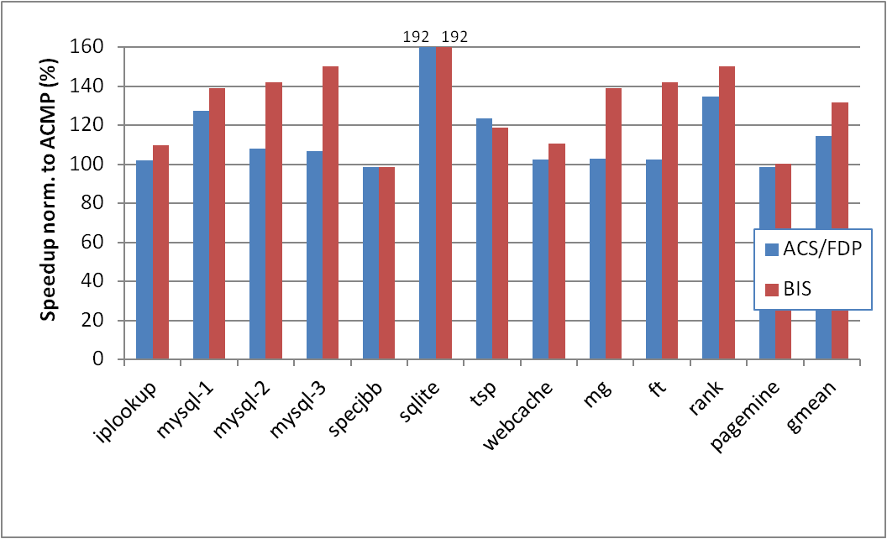
BIS Performance Improvement
Optimal number of threads, 28 small cores, 1 large core
limiting bottlenecks change over time
barriers, which ACS cannot accelerate
BIS outperforms ACS/FDP by 15% and ACMP by 32%
BIS improves scalability on 4 of the benchmarks
ACS
FDP

Slide 104
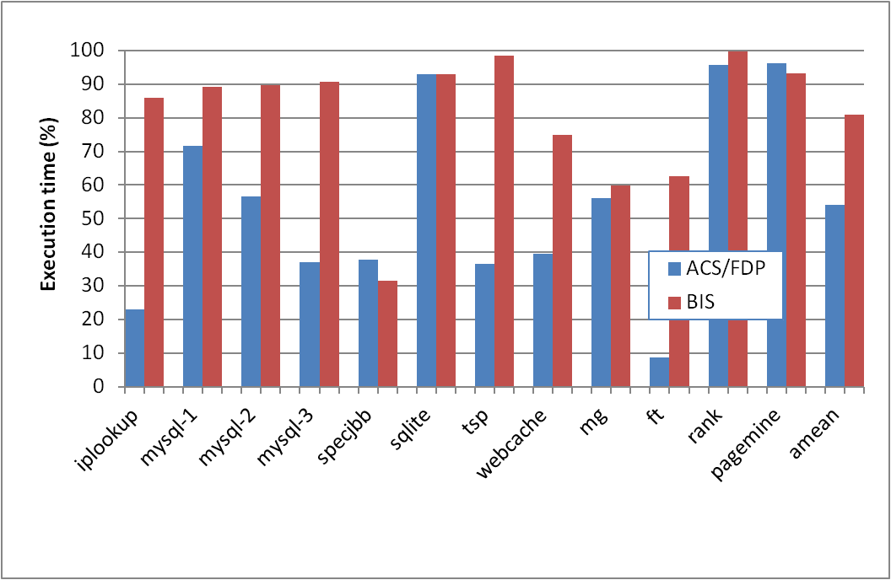
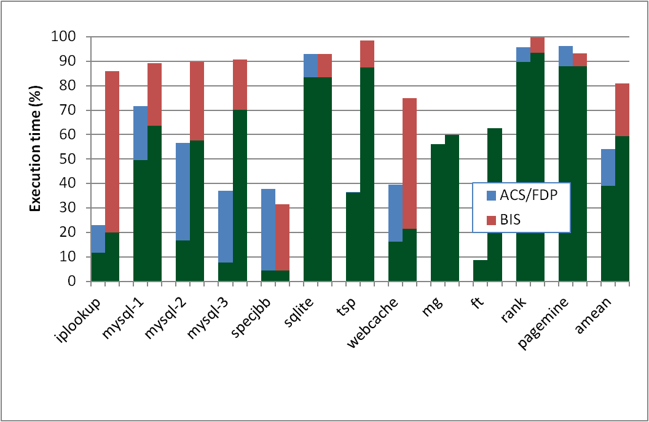
Why Does BIS Work?
Fraction of execution time spent on predicted-important bottlenecks
Actually critical
Coverage: fraction of program critical path that is actually identified as bottlenecks
39% (ACS/FDP) to 59% (BIS)
Accuracy: identified bottlenecks on the critical path over total identified bottlenecks
72% (ACS/FDP) to 73.5% (BIS)

Slide 105
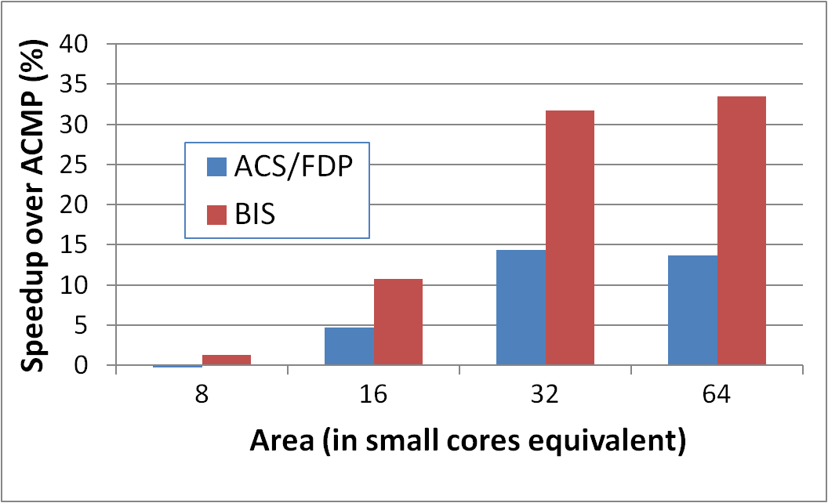
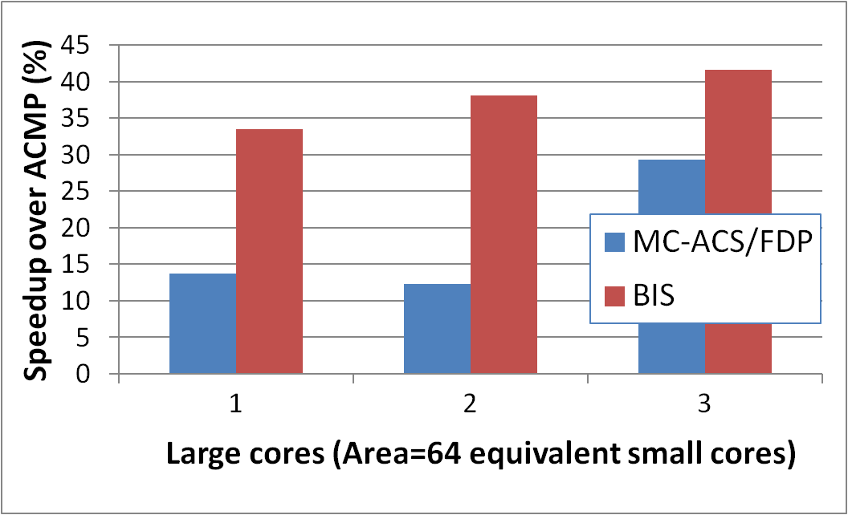
BIS Scaling Results
Performance increases with:
1) More small cores
Contention due to bottlenecks increases
Loss of parallel throughput due to large core reduces
2) More large cores
Can accelerate independent bottlenecks
Without reducing parallel throughput (enough cores)
15%
19%
6.2%
2.4%

Slide 106
BIS Summary
Serializing bottlenecks of different types limit performance of multithreaded applications: Importance changes over time
BIS is a hardware/software cooperative solution:
Dynamically identifies bottlenecks that cause the most thread waiting and accelerates them on large cores of an ACMP
Applicable to critical sections, barriers, pipeline stages
BIS improves application performance and scalability:
Performance benefits increase with more cores
Provides comprehensive fine-grained bottleneck acceleration with no programmer effort

Slide 107
More on Bottleneck Identification & Scheduling
Jose A. Joao, M. Aater Suleman, Onur Mutlu, and Yale N. Patt, "Bottleneck Identification and Scheduling in Multithreaded Applications" Proceedings of the 17th International Conference on Architectural Support for Programming Languages and Operating Systems (ASPLOS), London, UK, March 2012. Slides (ppt) (pdf)

Slide 108
Handling Private Data Locality: Data Marshaling
M. Aater Suleman, Onur Mutlu, Jose A. Joao, Khubaib, and Yale N. Patt, "Data Marshaling for Multi-core Architectures" Proceedings of the 37th International Symposium on Computer Architecture (ISCA), pages 441-450, Saint-Malo, France, June 2010.

Slide 109
Staged Execution Model (I)
Goal: speed up a program by dividing it up into pieces
Idea
Split program code into segments
Run each segment on the core best-suited to run it
Each core assigned a work-queue, storing segments to be run
Benefits
Accelerates segments/critical-paths using specialized/heterogeneous cores
Exploits inter-segment parallelism
Improves locality of within-segment data
Examples
Accelerated critical sections, Bottleneck identification and scheduling
Producer-consumer pipeline parallelism
Task parallelism (Cilk, Intel TBB, Apple Grand Central Dispatch)
Special-purpose cores and functional units
Notes:
Accelerate critical paths
Ship computation to data (A segmenting approach)

Slide 110
Staged Execution Model (II)
LOAD X
STORE Y
STORE Y
LOAD Y
….
STORE Z
LOAD Z
….
Notes:
Let me demonstrate the staged execution model pictorially. Assume that we have this contiguous chunk of code. I show only loads and stores since they are relevant to our work.

Slide 111
Staged Execution Model (III)
Split code into segments
Segment S0
LOAD X
STORE Y
STORE Y
Segment S1
LOAD Y
….
STORE Z
Segment S2
LOAD Z
….
Notes:
This figure shows the same chunk of code split into three segments, S0, S1, S2.
This split can be done statically and dynamically, and it is not the focus of our paper. However, I will soon show you two paradigms that split the code in different ways.

Slide 112
Staged Execution Model (IV)
Core 0
Core 1
Core 2
Work-queues
Instances of S0
Instances of S1
Instances of S2
Notes:
Once the split is done, each segment is assigned to a different core (this assignment can be done statically or dynamically, and again has been covered in previous work).
The work queue of each core contains the segments to be executed in that core.
In this example, S0 is executed in core 0, S1 executed in core 1, and so on.
*** Usually, to preserve locality and take advantage of customization, a segment is executed in one core.
*** This also preserves the locality of data that is commonly touched by instances of S0, S1, and S2 (intra-segment data, or shared data among instances of the same segment).

Slide 113
Staged Execution Model: Segment Spawning
Core 0
Core 1
Core 2
LOAD X
STORE Y
STORE Y
S0
LOAD Y
….
STORE Z
S1
LOAD Z
….
S2
Notes:
A segment that is executing on one core spawns another segment on another core, which in turn can spawn another segment in another core. These segments may need to communicate with each other because a later segment may need the data produced by a previous segment.
Segment spawning:
OLD:
When these segment runs on three cores P0, P1 and P2, core>>>
P1 incurs a cache miss to fetch Y and >>>
P2 incurs a cache miss to fetch Z
We cnan avoid these misses by shipping the data required by a segment to the core where the segment will run.

Slide 114
Staged Execution Model: Two Examples
Accelerated Critical Sections [Suleman et al., ASPLOS 2009]
Idea: Ship critical sections to a large core in an asymmetric CMP
Segment 0: Non-critical section
Segment 1: Critical section
Benefit: Faster execution of critical section, reduced serialization, improved lock and shared data locality
Producer-Consumer Pipeline Parallelism
Idea: Split a loop iteration into multiple “pipeline stages” where one stage consumes data produced by the previous stage → each stage runs on a different core
Segment N: Stage N
Benefit: Stage-level parallelism, better locality → faster execution
Notes:
Let me give you two concrete examples of staged execution models. I will extensively use these examples to show the benefits of data marshaling.

Slide 115
Problem: Locality of Inter-segment Data
Core 0
Core 1
Core 2
LOAD X
STORE Y
STORE Y
S0
Transfer Y
Cache Miss
LOAD Y
….
STORE Z
S1
Transfer Z
Cache Miss
LOAD Z
….
S2
Notes:
The problem is that when segments execute on different cores, they may need data produced by previous segments.
In this example, when S1 is executing Load to address Y on Core 1, it will incur a cache miss on the cache block containing Y because Core 0 was the last writer to that block.
If there is an inter-segment cache miss, the core that executes the segment will stall (or progress more slowly).
These intra-segment communication misses reduce the performance potential of staged execution.

Slide 116
Problem: Locality of Inter-segment Data
Accelerated Critical Sections [Suleman et al., ASPLOS 2010]
Idea: Ship critical sections to a large core in an ACMP
Problem: Critical section incurs a cache miss when it touches data produced in the non-critical section (i.e., thread private data)
Producer-Consumer Pipeline Parallelism
Idea: Split a loop iteration into multiple “pipeline stages” → each stage runs on a different core
Problem: A stage incurs a cache miss when it touches data produced by the previous stage
Performance of Staged Execution limited by inter-segment cache misses
Notes:
Let’s quickly take a look at what these misses look like in the two models we have discussed.
Remember in ACS, the critical sections are shipped to a large core. This means that the thread-private data that is produced outside the critical section and consumed inside it needs to be transferred to the large core when the critical section needs this data.
Similarly, in pipeline parallelism, …
…
But what is the effect of such cache misses on overall performance?

Slide 117
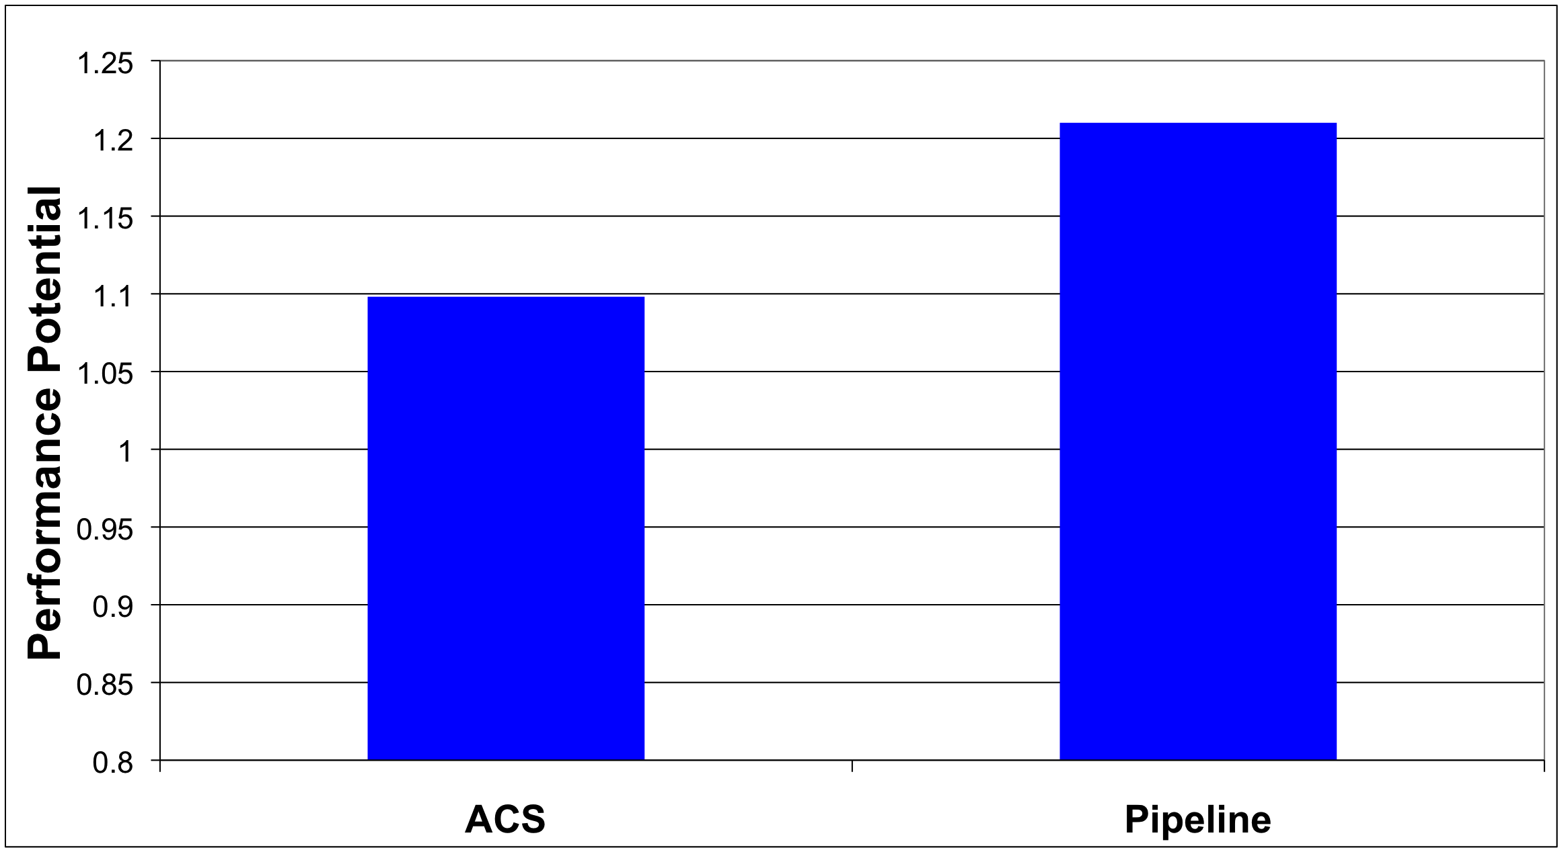
What if We Eliminated All Inter-segment Misses?

Slide 118
Terminology
Core 0
Core 1
Core 2
LOAD X
STORE Y
STORE Y
S0
Inter-segment data: Cache block written by one segment and consumed by the next segment
Transfer Y
LOAD Y
….
STORE Z
S1
Transfer Z
LOAD Z
….
Generator instruction: The last instruction to write to an inter-segment cache block in a segment
S2
Notes:
Let me first introduce some terminology. >>>
We call the data which is written by one segment and read by the next segment, inter-segment data >>>
In our example, Y and Z are intersegment data. >>>
We call the last instruction to modify intersegment data in a segment a generator. >>>
For example, The instructions which store Y and Z are generator instructions. >>>

Slide 119
Key Observation and Idea
Observation: Set of generator instructions is stable over execution time and across input sets
Idea:
Identify the generator instructions
Record cache blocks produced by generator instructions
Proactively send such cache blocks to the next segment’s core before initiating the next segment
Suleman et al., “Data Marshaling for Multi-Core Architectures,” ISCA 2010, IEEE Micro Top Picks 2011.
Notes:
We made a key observation that lead to the development of data marshaling. We found that across a wide variety of workloads …
Based on this observation, the basic idea is data marshaling is as follows:

Slide 120
Data Marshaling
Compiler/Profiler
Hardware
Identify generator instructions
Insert marshal instructions
Record generator-
produced addresses
Marshal recorded
blocks to next core
Binary containing generator prefixes & marshal Instructions
Notes:
DM consists of two components: Compiler and Hardware.

Slide 121
Data Marshaling
Compiler/Profiler
Hardware
Identify generator instructions
Insert marshal instructions
Record generator-
produced addresses
Marshal recorded
blocks to next core
Binary containing generator prefixes & marshal Instructions
Notes:
The job of the compiler is twofolds.

Slide 122
Profiling Algorithm
Inter-segment data
LOAD X
STORE Y
STORE Y
Mark as Generator Instruction
LOAD Y
….
STORE Z
LOAD Z
….
Notes:
The algorithm runs the program as a single thread and instruments all memory instructions.
Every time an instruction modifies a cache block, the algorithm stores the instruction’s IP as the last-writer of the cache block.
Every time a segment reads a cache block whose last writer is from previous segment, i.e., the data is inter-segment data, the last-writer is added to the generator set.
SPEND LESS TIME

Slide 123
Marshal Instructions
LOAD X
STORE Y
G: STORE Y
MARSHAL C1
When to send (Marshal)
Where to send (C1)
LOAD Y
….
G:STORE Z
MARSHAL C2
0x5: LOAD Z
….
Notes:
In addition to marking the generators, the compiler/library must also insert >>>
a Marshal instruction at the end of every segment.
The instruction informs the hardware that it is time to marshal the lines and the argument to the instruction tells it where the lines should be marshaled to.
(Inserted just before the point where the next segment is initiated)
If segments are not statically scheduled to the cores, the compiler would insert the segment id as argument to the MARSHAL instruction. This segment ID is later bound to a physical core ID via the runtime library or the hardware.
Marshal instructions can come free depending on SE model
SPEND LESS TIME
Binding between segment ID and core ID… accomplished by the runtime library or can be done with hardware dynamically as well if HW scheduling is employed.

Slide 124
DM Support/Cost
Profiler/Compiler: Generators, marshal instructions
ISA: Generator prefix, marshal instructions
Library/Hardware: Bind next segment ID to a physical core
Hardware
Marshal Buffer
Stores physical addresses of cache blocks to be marshaled
16 entries enough for almost all workloads → 96 bytes per core
Ability to execute generator prefixes and marshal instructions
Ability to push data to another cache

Slide 125
DM: Advantages, Disadvantages
Advantages
Timely data transfer: Push data to core before needed
Can marshal any arbitrary sequence of lines: Identifies generators, not patterns
Low hardware cost: Profiler marks generators, no need for hardware to find them
Disadvantages
Requires profiler and ISA support
Not always accurate (generator set is conservative): Pollution at remote core, wasted bandwidth on interconnect
Not a large problem as number of inter-segment blocks is small
Notes:
Pollution at remote core

Slide 126
Accelerated Critical Sections with DM
Large Core
LOAD X
STORE Y
G: STORE Y
CSCALL
Small Core 0
Addr Y
LOAD Y
….
G:STORE Z
CSRET
Critical Section
L2 Cache
L2 Cache
Data Y
Marshal Buffer
Cache Hit!
126
Notes:
126

Slide 127
Accelerated Critical Sections: Methodology
Workloads: 12 critical section intensive applications
Data mining kernels, sorting, database, web, networking
Different training and simulation input sets
Multi-core x86 simulator
1 large and 28 small cores
Aggressive stream prefetcher employed at each core
Details:
Large core: 2GHz, out-of-order, 128-entry ROB, 4-wide, 12-stage
Small core: 2GHz, in-order, 2-wide, 5-stage
Private 32 KB L1, private 256KB L2, 8MB shared L3
On-chip interconnect: Bi-directional ring, 5-cycle hop latency

Slide 128
DM on Accelerated Critical Sections: Results
168 170
8.7%
Notes:
I show the speedup of ACMP over SCMP where both of them employ data marshaling. DM improves performance by 8% for critical section-limited workloads and by 16% for pipeline workloads. In both cases, I also show an unrealistic ideal configuration where all misses to private and inter-stage data are artificially converted into hits. Notice that DM gets very close to this unrealistic ideal configuration.

Slide 129
Pipeline Parallelism
Cache Hit!
LOAD X
STORE Y
G: STORE Y
MARSHAL C1
Core 0
Core 1
S0
Addr Y
LOAD Y
….
G:STORE Z
MARSHAL C2
S1
L2 Cache
L2 Cache
Data Y
0x5: LOAD Z
….
Marshal Buffer
S2
129
Notes:
129
To implement DM, Each core is augmented with a >>>
Marshal Buffer. The marshal buffer stores the addresses of the cache lines to be marshaled. >>>
Every time a core encounters a Generator instruction, it enqueues the address of the cache line being written by the instruction in the marshal buffer. >>>
When a core hits a critical section, it ships al the lines pointed to by the marshal buffer entries to the large core. The large core encounters hits when it needs to access this data.

Slide 130
Pipeline Parallelism: Methodology
Workloads: 9 applications with pipeline parallelism
Financial, compression, multimedia, encoding/decoding
Different training and simulation input sets
Multi-core x86 simulator
32-core CMP: 2GHz, in-order, 2-wide, 5-stage
Aggressive stream prefetcher employed at each core
Private 32 KB L1, private 256KB L2, 8MB shared L3
On-chip interconnect: Bi-directional ring, 5-cycle hop latency

Slide 131
DM on Pipeline Parallelism: Results
16%
Notes:
I show the speedup of ACMP over SCMP where both of them employ data marshaling. DM improves performance by 8% for critical section-limited workloads and by 16% for pipeline workloads. In both cases, I also show an unrealistic ideal configuration where all misses to private and inter-stage data are artificially converted into hits. Notice that DM gets very close to this unrealistic ideal configuration.

Slide 132
DM Coverage, Accuracy, Timeliness
High coverage of inter-segment misses in a timely manner
Medium accuracy does not impact performance
Only 5.0 and 6.8 cache blocks marshaled for average segment

Slide 133
Scaling Results
DM performance improvement increases with
More cores
Higher interconnect latency
Larger private L2 caches
Why? Inter-segment data misses become a larger bottleneck
More cores → More communication
Higher latency → Longer stalls due to communication
Larger L2 cache → Communication misses remain
Notes:
Relative performance impact of inter-segment data cache misses increases with all three parameters

Slide 134
Other Applications of Data Marshaling
Can be applied to other Staged Execution models
Task parallelism models
Cilk, Intel TBB, Apple Grand Central Dispatch
Special-purpose remote functional units
Computation spreading [Chakraborty et al., ASPLOS’06]
Thread motion/migration [e.g., Rangan et al., ISCA’09]
Can be an enabler for more aggressive SE models
Lowers the cost of data migration
an important overhead in remote execution of code segments
Remote execution of finer-grained tasks can become more feasible → finer-grained parallelization in multi-cores

Slide 135
Data Marshaling Summary
Inter-segment data transfers between cores limit the benefit of promising Staged Execution (SE) models
Data Marshaling is a hardware/software cooperative solution: detect inter-segment data generator instructions and push their data to next segment’s core
Significantly reduces cache misses for inter-segment data
Low cost, high-coverage, timely for arbitrary address sequences
Achieves most of the potential of eliminating such misses
Applicable to several existing Staged Execution models
Accelerated Critical Sections: 9% performance benefit
Pipeline Parallelism: 16% performance benefit
Can enable new models→ very fine-grained remote execution

Slide 136
More on Bottleneck Identification & Scheduling
M. Aater Suleman, Onur Mutlu, Jose A. Joao, Khubaib, and Yale N. Patt, "Data Marshaling for Multi-core Architectures" Proceedings of the 37th International Symposium on Computer Architecture (ISCA), pages 441-450, Saint-Malo, France, June 2010. Slides (ppt)

Slide 137
Summary
Applications and phases have varying performance requirements
Designs evaluated on multiple metrics/constraints: energy, performance, reliability, fairness, …
One-size-fits-all design cannot satisfy all requirements and metrics: cannot get the best of all worlds
Asymmetry in design enables tradeoffs: can get the best of all worlds
Asymmetry in core microarch. → Accelerated Critical Sections, BIS, DM → Good parallel performance + Good serialized performance
Asymmetry in memory scheduling → Thread Cluster Memory Scheduling → Good throughput + good fairness
Simple asymmetric designs can be effective and low-cost

Slide 138
Readings: Heterogeneous Cores
M. Aater Suleman, Onur Mutlu, Moinuddin K. Qureshi, and Yale N. Patt, "Accelerating Critical Section Execution with Asymmetric Multi-Core Architectures" Proceedings of the 14th International Conference on Architectural Support for Programming Languages and Operating Systems (ASPLOS), pages 253-264, Washington, DC, March 2009. Slides (ppt)
M. Aater Suleman, Onur Mutlu, Jose A. Joao, Khubaib, and Yale N. Patt, "Data Marshaling for Multi-core Architectures" Proceedings of the 37th International Symposium on Computer Architecture (ISCA), pages 441-450, Saint-Malo, France, June 2010. Slides (ppt)
Jose A. Joao, M. Aater Suleman, Onur Mutlu, and Yale N. Patt, "Bottleneck Identification and Scheduling in Multithreaded Applications" Proceedings of the 17th International Conference on Architectural Support for Programming Languages and Operating Systems (ASPLOS), London, UK, March 2012. Slides (ppt) (pdf)
Jose A. Joao, M. Aater Suleman, Onur Mutlu, and Yale N. Patt, "Utility-Based Acceleration of Multithreaded Applications on Asymmetric CMPs" Proceedings of the 40th International Symposium on Computer Architecture (ISCA), Tel-Aviv, Israel, June 2013. Slides (ppt) Slides (pdf)

Slide 139
A Case for Asymmetry Everywhere
Onur Mutlu, "Asymmetry Everywhere (with Automatic Resource Management)" CRA Workshop on Advancing Computer Architecture Research: Popular Parallel Programming, San Diego, CA, February 2010. Position paper

Slide 140
Asymmetry Enables Customization
Symmetric: One size fits all
Energy and performance suboptimal for different phase behaviors
Asymmetric: Enables tradeoffs and customization
Processing requirements vary across applications and phases
Execute code on best-fit resources (minimal energy, adequate perf.)
C
C
C
C
C1
C2
C
C
C
C
C3
C
C
C
C
C4
C4
C4
C4
C
C
C
C
C5
C5
C5
C5
Symmetric
Asymmetric

Slide 141
Thought Experiment: Asymmetry Everywhere
Design each hardware resource with asymmetric, (re-)configurable, partitionable components
Different power/performance/reliability characteristics
To fit different computation/access/communication patterns

Slide 142
Thought Experiment: Asymmetry Everywhere
Design the runtime system (HW & SW) to automatically choose the best-fit components for each phase
Satisfy performance/SLA with minimal energy
Dynamically stitch together the “best-fit” chip for each phase
Phase 1
Phase 2
Phase 3

Slide 143
Thought Experiment: Asymmetry Everywhere
Morph software components to match asymmetric HW components
Multiple versions for different resource characteristics
Version 1
Version 2
Version 3

Slide 144
Many Research and Design Questions
How to design asymmetric components?
Fixed, partitionable, reconfigurable components?
What types of asymmetry? Access patterns, technologies?
What monitoring to perform cooperatively in HW/SW?
Automatically discover phase/task requirements
How to design feedback/control loop between components and runtime system software?
How to design the runtime to automatically manage resources?
Track task behavior, pick “best-fit” components for the entire workload

Slide 145
Exploiting Asymmetry: Simple Examples
Serial
Parallel
Execute critical/serial sections on high-power, high-performance cores/resources [Suleman+ ASPLOS’09, ISCA’10, Top Picks’10’11, Joao+ ASPLOS’12,ISCA’13]
Programmer can write less optimized, but more likely correct programs

Slide 146
Exploiting Asymmetry: Simple Examples
VLIW Backend
OoO
Backend
Execute each code block on the most efficient execution backend for that block [Fallin+ ICCD’14]
Enables a much more efficient and still high performance core design

Slide 147
Exploiting Asymmetry: Simple Examples
Streaming
Random access
Execute streaming “memory phases” on streaming-optimized cores and memory hierarchies
More efficient and higher performance than general purpose hierarchy

Slide 148
Exploiting Asymmetry: Simple Examples
Bandwidth optimized NoC
Latency optimized NoC
Execute bandwidth-sensitive threads on a bandwidth-optimized network, latency-sensitive ones on a latency-optimized network [Das+ DAC’13]
Higher performance and energy-efficiency than a single network

Slide 149
Exploiting Asymmetry: Simple Examples
Bandwidth sensitive
Latency sensitive
Partition memory controller and on-chip network bandwidth asymmetrically among threads [Kim+ HPCA 2010, MICRO 2010, Top Picks 2011] [Nychis+ HotNets 2010] [Das+ MICRO 2009, ISCA 2010, Top Picks 2011]
Higher performance and energy-efficiency than symmetric/free-for-all

Slide 150
Exploiting Asymmetry: Simple Examples
Compute intensive
Memory intensive
Have multiple different memory scheduling policies apply them to different sets of threads based on thread behavior [Kim+ MICRO 2010, Top Picks 2011] [Ausavarungnirun+ ISCA 2012]
Higher performance and fairness than a homogeneous policy

Slide 151
Exploiting Asymmetry: Simple Examples
CPU
DRAMCtrl
PCM Ctrl
DRAM
Phase Change Memory (or Tech. X)
Fast, durable
Small,
leaky, volatile,
high-cost
Large, non-volatile, low-cost
Slow, wears out, high active energy
DRAM
Phase Change Memory
Build main memory with different technologies with different characteristics (e.g., latency, bandwidth, cost, energy, reliability) [Meza+ IEEE CAL’12, Yoon+ ICCD’12, Luo+ DSN’14]
Higher performance and energy-efficiency than homogeneous memory

Slide 152
Exploiting Asymmetry: Simple Examples
Reliable DRAM
Less Reliable DRAM
Build main memory with different technologies with different characteristics (e.g., latency, bandwidth, cost, energy, reliability) [Meza+ IEEE CAL’12, Yoon+ ICCD’12, Luo+ DSN’14]
Lower-cost than homogeneous-reliability memory at same availability

Slide 153
Exploiting Asymmetry: Simple Examples
Heterogeneous-Latency DRAM
Heterogeneous-Refresh-Rate DRAM
Design each memory chip to be heterogeneous to achieve low latency and low energy at reasonably low cost [Lee+ HPCA’13, Liu+ ISCA’12]
Higher performance and energy-efficiency than single-level memory

Slide 154
Memory Systems Fundamentals, Recent Research, Challenges, Opportunities Lecture 8: Asymmetric Multi-Core
Prof. Onur Mutlu
omutlu@gmail.com
https://people.inf.ethz.ch/omutlu
11 October 2018
Technion Fast Course 2018

Slide 155


Utility-Based Acceleration of Multithreaded Applications on Asymmetric CMPs
José A. Joao*
M. Aater Suleman*
Onur Mutlu‡
Yale N. Patt*
* HPS Research Group University of Texas at Austin
‡ Computer Architecture Laboratory
Carnegie Mellon University

Slide 156
Asymmetric CMP (ACMP)
Small
core
Small
core
Large core
Small
core
Small
core
Small
core
Small
core
Small
core
Small
core
Small
core
Small
core
Small
core
Small
core
One or a few large, out-of-order cores, fast
Many small, in-order cores, power-efficient
Critical code segments run on large cores
The rest of the code runs on small cores
???

Slide 157
Bottlenecks
T0
T1
T2
T3
Barrier 1
Barrier 2
Accelerating Critical Sections (ACS), Suleman et al., ASPLOS’09
T0
T1
T2
T3
Barrier 1
Barrier 2
Bottleneck Identification and Scheduling (BIS), Joao et al., ASPLOS’12

Slide 158
Lagging Threads
Lagging thread = potential future bottleneck
Execution time reduction
Progress P0 =
10
T0
P1 =
11
T1
P2 =
6
T2
P3 =
10
T3
Barrier 1
t1
Barrier 2
t2
Barrier 2
T2: Lagging thread
Previous work about progress of multithreaded applications:
Meeting points, Cai et al., PACT’08
Thread criticality predictors, Bhattacharjee and Martonosi, ISCA’09
Age-based scheduling (AGETS), Lakshminarayana at al., SC’09

Slide 159
Two problems
1) Do we accelerate bottlenecks or lagging threads?
2) Multiple applications: which application do we accelerate?
Application 1
T0
T1
Acceleration decisions need to consider both:
- the criticality of code segments
- how much speedup they get
T2
T3
Application 2
for lagging threads and bottlenecks
T0
T1
T2
T3
t1

Slide 160
Utility-Based Acceleration (UBA)
Goal: identify performance-limiting bottlenecks or lagging threads from any running application and accelerate them on large cores of an ACMP
Key insight: a Utility of Acceleration metric that combines speedup and criticality of each code segment
Utility of accelerating code segment c of length t on an application of length T:
L
R
G

Slide 161
L: Local acceleration of c
How much code segment c is accelerated
Estimate S = estimate performance on a large core while running on a small core
Performance Impact Estimation (PIE, Van Craeynest et al., ISCA’12) : considers both instruction-level parallelism (ILP) and memory-level parallelism (MLP) to estimate CPI
t
c running on small core
∆t
c running on large core
t_{LargeCore}
S: speedup of c

Slide 162
R: Relevance of code segment c
How relevant code segment c is for the application
t_{lastQ}
t
T
Q
Q
Q: scheduling quantum

Slide 163
G: Global effect of accelerating c
How much accelerating c reduces total execution time
→ Acceleration of application
Criticality of c
→ Acceleration of c
t
Single thread
c running on small core
∆t
∆T
G=1
c running on large core

Slide 164
G: Global effect of accelerating c
How much accelerating c reduces total execution time
Critical sections: classify into strongly-contended and weakly-contended and estimate G differently (in the paper)
→ Acceleration of application
Criticality of c
→ Acceleration of c
Idle
T1
G=0
T2
G=1/2
T3
Barrier
2 quanta to get the benefit of 1

Slide 165
Utility-Based Acceleration (UBA)
Bottleneck
Identification
Lagging Thread
Identification
Set of Highest-Utility
Bottlenecks
Set of Highest-Utility
Lagging Threads
Acceleration
Coordination
Large core control

Slide 166
Lagging thread identification
Lagging threads are those that are making the least progress
How to define and measure progress? → Application-specific problem
We borrow from Age-Based Scheduling (SC’09)
Progress metric (committed instructions)
Assumption: same number of committed instructions between barriers
But we could easily use any other progress metric…
Minimum progress = minP
Set of lagging threads = { any thread with progress < minP + ∆P }
Compute Utility for each lagging thread

Slide 167
Utility-Based Acceleration (UBA)
Bottleneck
Identification
Lagging Thread
Identification
Set of Highest-Utility
Bottlenecks
Set of Highest-Utility
Lagging Threads
Acceleration
Coordination
1 per large core
Large core control

Slide 168
Bottleneck identification
Software: programmer, compiler or library
Delimit potential bottlenecks with BottleneckCall and BottleneckReturn instructions
Replace code that waits with a BottleneckWait instruction
Hardware: Bottleneck Table
Keep track of threads executing or waiting for bottlenecks
Compute Utility for each bottleneck
Determine set of Highest-Utility Bottlenecks
Similar to our previous work BIS, ASPLOS’12
BIS uses thread waiting cycles instead of Utility

Slide 169
Utility-Based Acceleration (UBA)
Bottleneck
Identification
Lagging Thread
Identification
Set of Highest-Utility
Bottlenecks
Set of Highest-Utility
Lagging Threads
Acceleration
Coordination
Large core control

Slide 170
Acceleration coordination
LT assigned to each large core every quantum
Scheduling Buffer
Large
Cores
No more bottlenecks
→ LT3 returns to large core
Set of Highest-Utility
Lagging Threads
LT: lagging
threads
LT1
LT2
LT3
LT3
LT3
LT4
U_{LT1} > U_{LT2} > U_{LT3} > U_{LT4}
U: utility
Small
Cores
Bottleneck Acceleration
Utility Threshold (BAUT)
B1
B2
B: bottlenecks
U_{B1} > BAUT
U_{B2} > BAUT
Bottleneck B2 will be enqueued
Bottleneck B1 will preempt lagging thread LT3

Slide 171
Methodology
Workloads
single-application: 9 multithreaded applications with different impact from bottlenecks
2-application: all 55 combinations of (9 MT + 1 ST)
4-application: 50 random combinations of (9 MT + 1 ST)
Processor configuration
x86 ISA
Area of large core = 4 x Area of small core
Large core: 4GHz, out-of-order, 128-entry ROB, 4-wide, 12-stage
Small core: 4GHz, in-order, 2-wide, 5-stage
Private 32KB L1, private 256KB L2, shared 8MB L3
On-chip interconnect: Bi-directional ring, 2-cycle hop latency

Slide 172
Comparison points
Single application
ACMP (Morad et al., Comp. Arch. Letters’06)
only accelerates Amdahl’s serial bottleneck
Age-based scheduling (AGETS, Lakshminarayana et al., SC’09)
only accelerates lagging threads
Bottleneck Identification and Scheduling (BIS, Joao et al., ASPLOS’12)
only accelerates bottlenecks
Multiple applications
AGETS+PIE: select most lagging thread with AGETS and use PIE across applications
only accelerates lagging threads
MA-BIS: BIS with shared large cores across applications
only accelerates bottlenecks

Slide 173
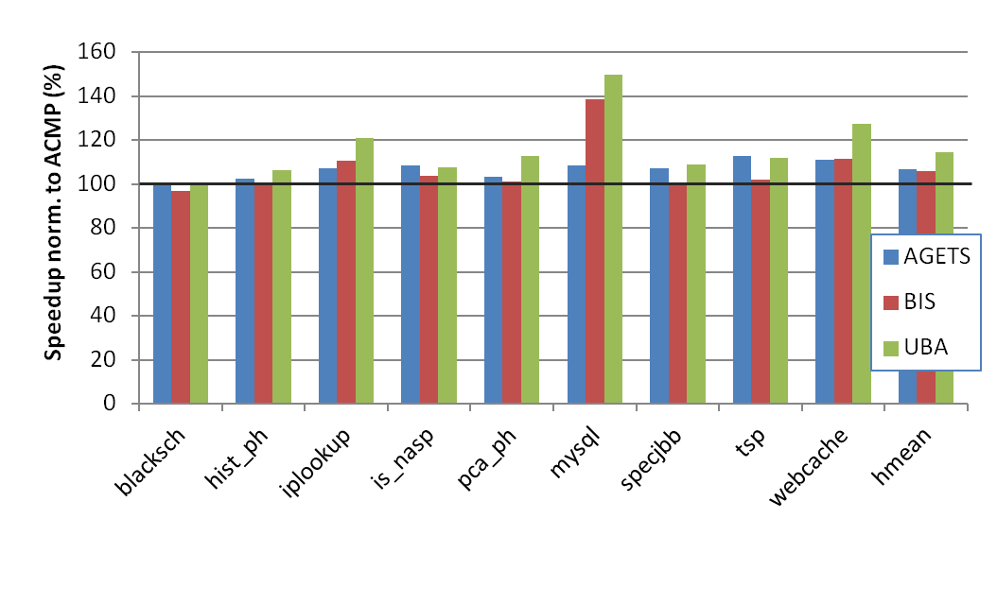
Single application, 1 large core
Optimal number of threads, 28 small cores, 1 large core
Neither bottlenecks
nor lagging threads
UBA outperforms both AGETS and BIS by 8%
Lagging threads: benefit from AGETS and UBA
Limiting critical sections: benefit from BIS and UBA
UBA’s benefit increases with area budget and number of large cores

Slide 174
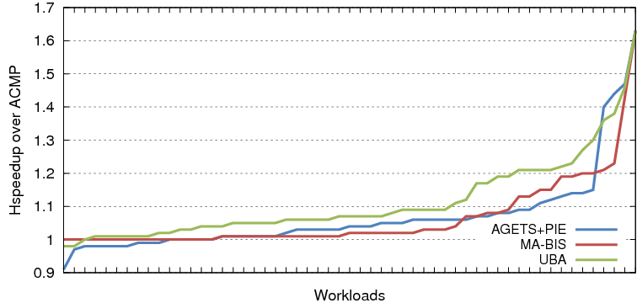
Multiple applications
2-application workloads, 60 small cores, 1 large core
1
55
UBA improves Hspeedup over AGETS+PIE and MA-BIS by 2 to 9%

Slide 175
Summary
To effectively use ACMPs:
Accelerate both fine-grained bottlenecks and lagging threads
Accelerate single and multiple applications
Utility-Based Acceleration (UBA) is a cooperative software-hardware solution to both problems
Our Utility of Acceleration metric combines a measure of acceleration and a measure of criticality to allow meaningful comparisons between code segments
Utility is implemented for an ACMP but is general enough to be extended to other acceleration mechanisms
UBA outperforms previous proposals for single applications and their aggressive extensions for multiple-application workloads
UBA is a comprehensive fine-grained acceleration proposal for parallel applications without programmer effort

Slide 176
Thank You!
Questions?

Slide 177
Utility-Based Acceleration of Multithreaded Applications on Asymmetric CMPs
José A. Joao*
M. Aater Suleman*
Onur Mutlu‡
Yale N. Patt*
* HPS Research Group University of Texas at Austin
‡ Computer Architecture Laboratory
Carnegie Mellon University

